Slide 1
B2W Pricing Challenge 2016 André Teixeira dos Santos 30 / 09 / 2016

Slide 2
OBJECTIVES
“predict the quantity sold for a each product given a prescribed price”
"we need metrics, relationships and descriptions of these data in order to understand the sales behavior. What does the data tell us? How are the different data sources related?”
“what were the steps and your strategy (approach to the problem)”
“ - Show a understanding of SQL;
- Use Version Control (Git for example);
- Show methods for clustering;”

Slide 3
CONTENTS
Objectives
Overview
Technologies & Approach
Process Overview
Premises and Simplifications
Remarks About the Data
Basic Analytics
Pricing Analytics
Modeling

Slide 4
OVERVIEW

Slide 5


TECHNOLOGIES & APPROACH
Load: CSVs checked and load at MySQL.
Data Preparation in MySQL: Indexing, renaming, horizontal enhancements (e.g., day of week), dimensional aggregations (e.g., summary of a day).
Basic Visualizations & Analysis: basic analysis using Metabase summarizations and time series views, averages of prices and volumes. R histograms, boxplots & scatterplots.
Analytics & Insights: development of indicators, creation of more aggregated table and summaries, compilation of insights throught MySQL and Metabase.
Modeling: development of models that tries do predict volume of sales for a given product, using avaiable information (not only price). Naive forecasting method used has benchmark.
Metabase
MySQL
CSV
Queries

Slide 6
PROCESS OVERVIEW
basic data preparation
basic analytics
first modeling attempt: linear regression (cross-sectional predictors)
second modeling attempt: vector autoregression (VAR & SVAR)
advanced data preparation & pricing analytics
third modeling attempt: dynamic models (cross-sectional predictors + lagged and differentiated predictors)
fourth modeling attempt: clustering + dynamic models
consolidation of results & presentation

Slide 7
PREMISSES AND SIMPLIFICATIONS
the nominal/base price for a product, for a given day, was considered as the maximum price for that day
outliers were not treated
inner joins were used to combine sales and competitors prices to avoid dealing with missing data, resulting in a decreased dataset
the models were developed for 1 product (P2) and inter-products effects were not considered (e.g., substitute goods), i.e., it was assumed products sales were not negatively correlated
neural networks and other non-linear models were not considered due to increase in complexity and labor, and loss in interpretability.
for all regression models the mean absolute error (MAE) was used to evaluated the model performance and for benchmarking was used the MAE of naive and mean forecasting methods. Other performance metrics like R² were not considered.

Slide 8
REMARKS ABOUT THE DATA
some prices from the competitors monitoring csv looked like were multiplied by 10, so it was divided back in the staging area.
each product had a different temporal window, being for sale or competitor monitoring.
the claim that the price was captured twice a day was not precise, i.e., it could be more or less than that and also, it could be at the same time, which has no use.
price is not a good predictor for volume, as the requirements led to believe.

Slide 9
BASIC ANALYTICS

Slide 10
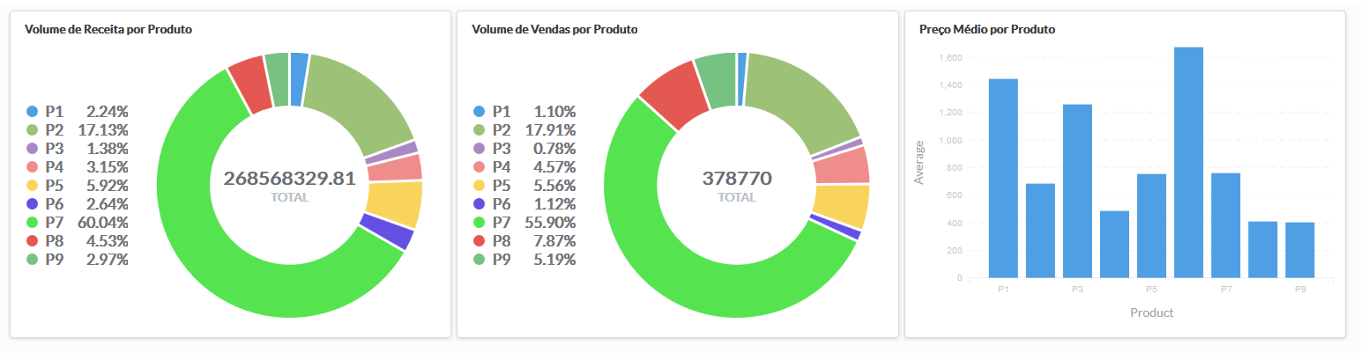
BASIC ANALYTICS – AGGREGATIONS

Slide 11
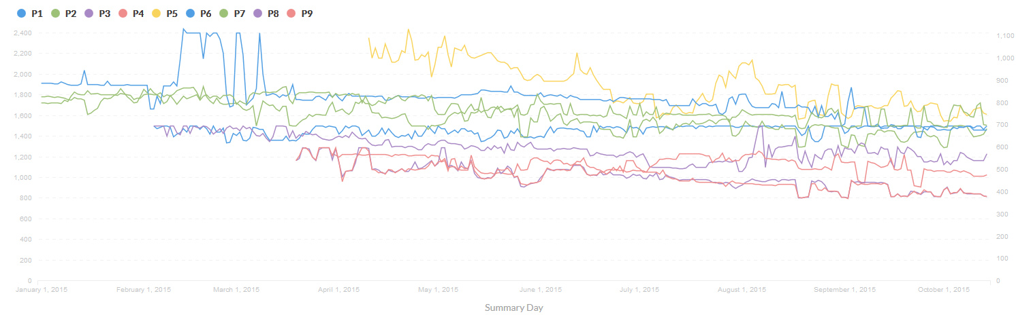
BASIC ANALYTICS – PRICE TIME SERIES
Averege price in day
Distinct windows of time
Looks like white noise

Slide 12
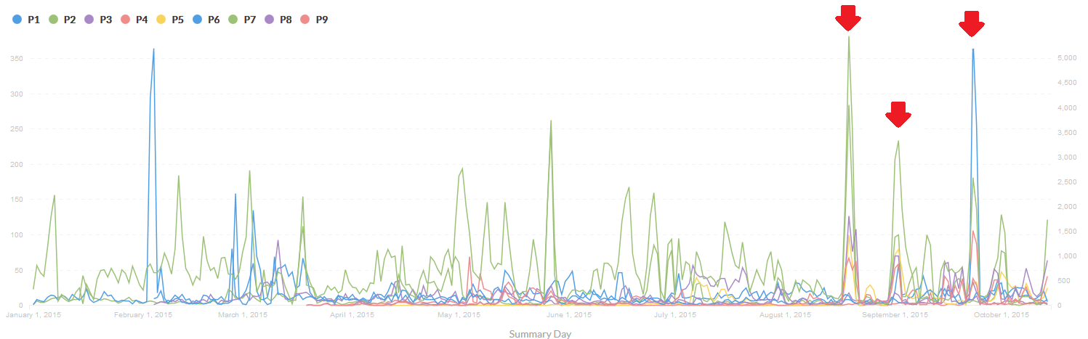
BASIC ANALYTICS – VOLUME TIME SERIES
Considerable oscillations
Looks like that are market spikes for all products (global campaigns or intrinsic market seasonality)
Average inter-product positive correlation

Slide 13
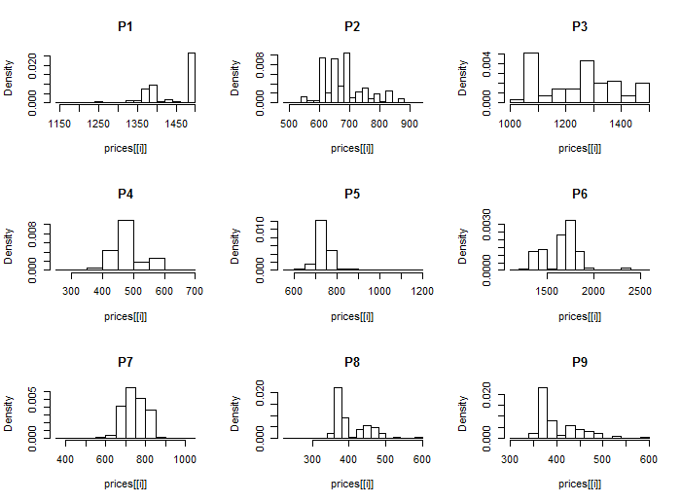
BASIC ANALYTICS – PRICES HISTOGRAM

Slide 14
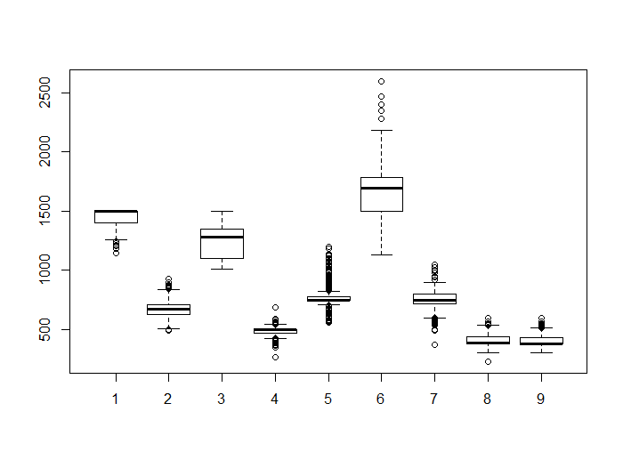
BASIC ANALYTICS – PRICES BOXPLOTS

Slide 15
PRICING ANALYTICS

Slide 16
ANALYTICS – PRICING INDICATORS
pricing efficiency: how well is the competitor able to keep its prices bellow mine, for each product?
pricing influence: how does the competitors prices impacts my sales, for each product, i.e., when he has lower prices, does my sales volume decreases?
pricing relevancy: what products should I focus on, to give a more intelligent pricing strategy, i.e., what products represents a greater revenue for me and are more sensible to competitive prices?

Slide 17
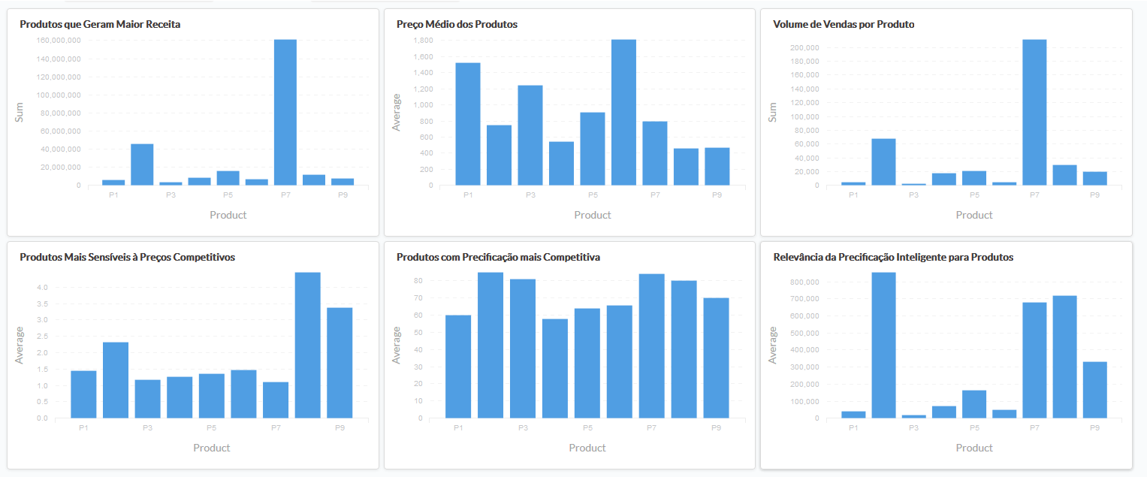
ANALYTICS – PRODUCTS INDICATORS

Slide 18
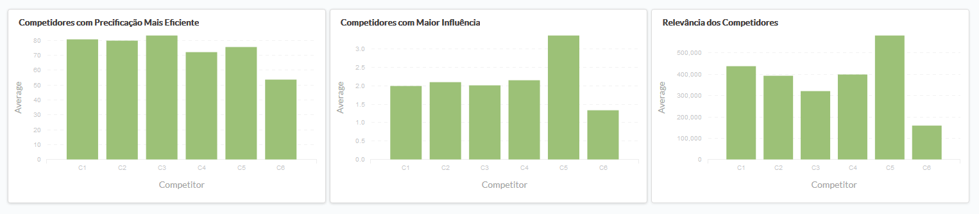
ANALYTICS – COMPETITORS INDICATORS

Slide 19
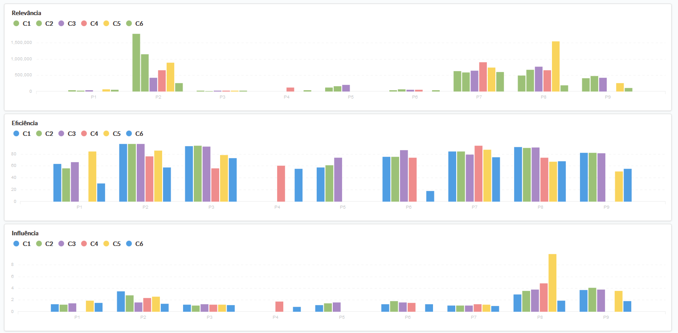
ANALYTICS – GRAIN INDICATORS

Slide 20
ANALYTICS – SOME INSIGHTS
C5 is the main competitor
P7 is the main product
P2, P8 and P7 are the products who mostly require smart pricing
Despite its prices, P2 is preferred by consumers to be bought at competitors
It’s probable that consumers looks at C5 for P2 prices first.
C6 is niche, i.e., consumers buy there no matter the price.

Slide 21
MODELING

Slide 22
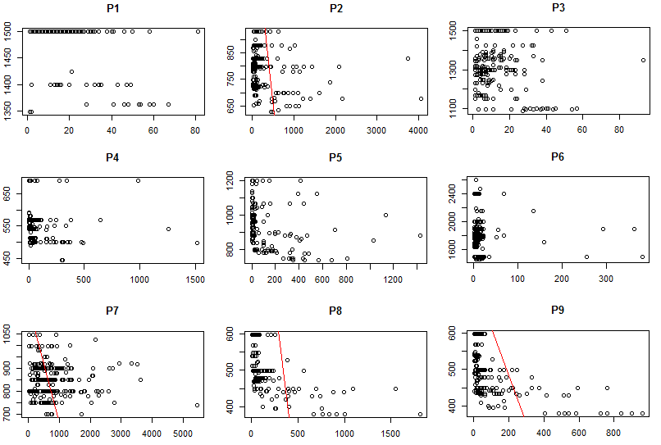
MODELING – VOLUME x PRICE SCATTERPLOTS

Slide 23
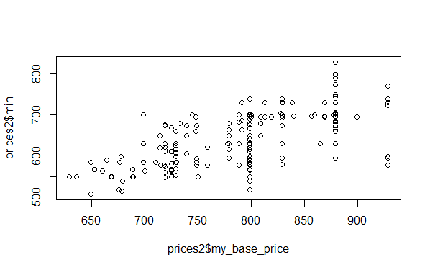
MODELING – PRICE x COMPETITORS PRICE

Slide 24
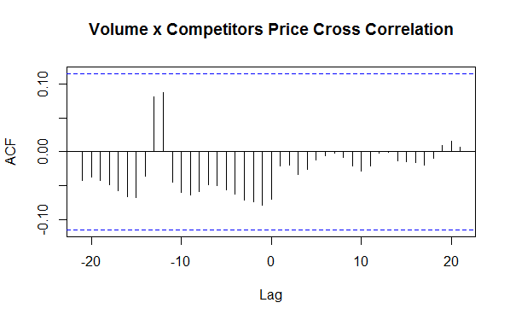
MODELING – VOLUME x COMPETITORS PRICE

Slide 25
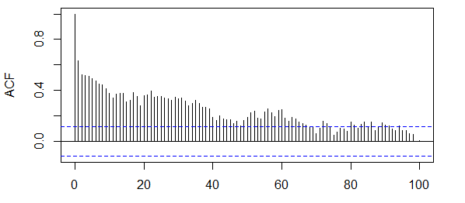
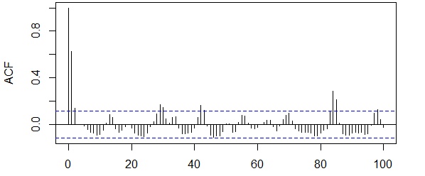
MODELING – AUTOCORRELATION
PRICE
VOLUME

Slide 26
MODELING – STRATEGIES & APPROACHES
Linear Regression
Price alone isn’t good predictors
Use other cross-sectional predictors, e.g., day of week, competitors price, day of month
Mean absolute error (MAE) didn’t improve against benchmark (naive forecasting method)
Vector Autoregression (VAR & SVAR)
Use lagged values of volume, price and competitors prices time series to predict volume
VAR didn’t attend test requirements and SVAR would be too complex.
Dynamic Models
Manually combine cross-sectional data with lagged and differentiated value from multiple time series into a linear regression
MAE didn’t improve against benchmark
Clustering + Dynamic Models
Predictor hidden somewhere
“Show mtehods for clustering”
Clustering the days of the year (days that have a particular effect on volume behaviour)
Kmeans with 6 centers chosen (based on whitin cluster sum of squares evolution)
Improvement of 75% against benchmark!
Predictors used: price, cluster, competitors minimum price, volume of the day before (lag 1)

Slide 27
MODELING – RESULTS FOR P2
Average volume: 291 items per day
Mean absolute error for benchmark (naive): 200 items
70% of average volume
Mean absolute error for model with clustering: 46 items
16% of average volume
75% decreased error against benchmark!

Slide 28
END

